Slide 1
Cloud Computing : An efficient way of resource utilization
Presented by :-
Gaurav Raj(20168081)
Abhishek Kumar(20168039)
Diwakar Verma(20168075)
Submitted to :-
Dr. Dushyant Kumar Singh
Department of Computer Science and Engineering
MNNIT Allahabad

Slide 2
Cloud Computing
Cloud computing is an emerging technology that provides on-demand resources for varying requirements on a leased basis, i.e., Pay As You Go (PAYG) model.
Cloud computing provides computing services like servers, storage, databases, networking, software, etc.
Cloud providers use virtualization based approach in order to build their stack.

Slide 3
Importance of Cloud Computing
Cloud computing helps in reducing an organization’s expenditure since the organization does not need to invest in expensive hardware, storage devices and software.
Cloud computing enables you to reduce and increase your resources demands as per your requirements.
All the software maintenance and upgrades are looked after and regulated by the cloud service provider.

Slide 4
Importance of Cloud Computing
Cloud computing enables employees to work in a more collaborative and coordinated manner.
Cloud computing services have a very prompt and customer-centric SLA’s (Service Level Agreements).

Slide 5
Cloud Service Models
There are three types of services that are being provided by the cloud model-
Software-as-a-Service (SaaS) is a way of delivering services and applications over the Internet. Examples- Google Apps, BigCommerce, Dropbox etc.
Platform as a service (PaaS) provides a platform and environment to allow developers to build applications and services over the internet. Examples- AWS Elastic Beanstalk, Windows Azure etc.
Infrastructure as a service (IaaS) delivers computer infrastructure on an outsourced basis to support various operations. Examples- AWS EC2, Google Compute Engine(GCE) etc.

Slide 6
Virtualization
Virtualization refers to the act of creating a virtual version of computing resources, including computer hardware platforms, storage devices, etc.
Virtualization makes it possible to run multiple operating systems and multiple applications on the same server at the same time.
Virtualization makes physical resources of infrastructure dynamically map to the drive of the application.
Virtualization can be implemented with virtual machines and containers.

Slide 7
Virtual Machines
The virtual machine is implemented as a combination of a real machine and virtualization software.
The virtual machine may have resources different from the real machine, either in quantity or in type.
Virtual machines are software computers that provide the same functionality as physical computers.
Virtual machines are created to perform specific tasks that are risky to perform in a host environment.

Slide 8
Containers
A container is a lightweight, stand-alone, executable package of a piece of software that includes everything needed to run it, i.e., code, runtime environment and system libraries.
Using containers a developer can package up an application with all the parts it needs, like libraries and other dependencies and it can be shipped out as a single package.

Slide 9
VMs vs. Containers
Containers and VMs are similar in their goals: to isolate an application and its dependencies into a self-contained unit that can run anywhere.
The most important difference between containers and VMs is that containers share the host systems kernel with other containers. This is what makes containers so lightweight.
Unlike a VM which provides hardware virtualization, a container provides operating-system-level virtualization by abstracting the user space.

Slide 10
VMs vs. Containers
Containers are application level construct and emulate numerous virtual environments which share a single kernel.
Containers have many advantages over virtual machines like, it is light-weight, all containers share the same host OS, its startup time is in milliseconds and it requires less memory space.

Slide 11
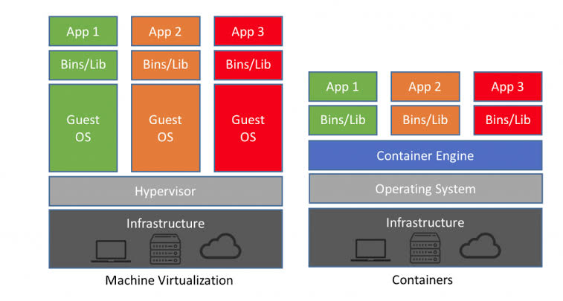
VMs vs. Containers
Fig.- VM vs. Containers

Slide 12
Elasticity and Scaling
There should be some way to add or remove resources from a container and hence comes the concept of elasticity.
Elasticity is the ability of a system to add and remove resources to adopt the load variation in real time.
It is the dynamic property of cloud computing that allows the system to scale on-demand in an operational system.

Slide 13
Elasticity and Scaling
There are two terms which are associated with elasticity and they are scalability and efficiency.
Scalability is the ability of the system to sustain varying workloads by making use of additional resources.
Efficiency characterizes how cloud resources can be efficiently utilized as it scales up or down to increase the throughput.

Slide 14
Elasticity and Scaling
There are two types of Elasticity, i.e., Horizontal and Vertical.
In horizontal elasticity new instances of computing resources can be added or existing resources can be removed according to the requirements.
In vertical elasticity existing properties of the computing can be changed according to the user requirements like memory, CPU time, cores, etc.

Slide 15
Elasticity and Scaling
There are two types of scaling models, i.e., Reactive and Proactive.
Reactive model is used to scale the number of containers by comparing the resource utilization within the containers with a threshold value.
Proactive model is also used to scale the number of containers by forecasting the future load or future resource requirements using past records.

Slide 16
Load Balancing
Load balancing is a process of distributing the workload dynamically and uniformly across all the available nodes.
By shifting the workloads among different nodes, the overall performance of a system can be improved.
Major goals of load balancing algorithm are to provide availability, performance and ﬂexibility.

Slide 17
Load Balancing
There are two types of load balancing, i.e., Layer 4 and Layer 7 load balancing.
Layer 4 load balancing is one of the simplest way to load balance the traffic and demands to multiple servers on the basis of IP range and port.
Layer 7 load balancing is the more complex way for load balancing the network traffic. It allows the load balancer to forward various requests to different backend servers depending on the content of the user’s request

Slide 18
Load Balancing
There are various types of load balancing algorithms but generally load balancing algorithms are divided into two categories on the basis of present system state.
Static Algorithms are good for homogeneous and stable environment. These algorithms divide the traffic equally among all the available servers.
Dynamic Algorithms are good for heterogeneous environment. This approach is helpful when we want to distribute the workloads depending on the current state of the system.

Slide 19
Load Balancer
A load balancer is a piece of hardware (or software) that acts like a reverse proxy to distribute network and/or application traffic across different servers.
A load balancer helps to improve these by distributing the workload across multiple servers, decreasing the overall burden placed on each server.
A load balancer is used to improve the concurrent user capacity and overall reliability of applications.
The following are few examples of software load balancers: HAProxy, NGINX, Varnish, etc.

Slide 20
HAProxy:
HAProxy stands for High Availability Proxy, which is a popular open source software used as TCP/HTTP load balancer and proxying solution.
It acts as a TCP proxy which can accept a TCP connection from a listening socket and then connect to a server.
It also acts as a server load balancer which is used for load balancing TCP connections and HTTP requests.
It spreads various requests across multiple servers in order to optimize resource usage, maximize throughput, avoid overloading and minimize response time.

Slide 21
HAProxy Algorithms:
Round Robin:- This algorithm chooses the servers sequentially in turns from the servers list. By default, HAProxy uses this algorithm.
Least Connection:- This algorithm selects the server having few active connections and then forwards the request to the backend.
Source:- This algorithm is used to select the server based on the source IP address using the hash to connect it to the matching server.

Slide 22
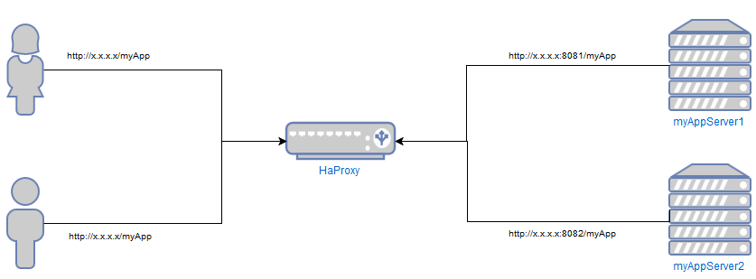
HAProxy contd..
Figure: HAProxy Configuration
HAProxy consists of frontend and backend.

Slide 23
TOPSIS (Technique for Order of Preferences by Similarity to Ideal Solution)
TOPSIS is a multi-criteria decision analysis method.
It simply compares the set of alternatives by identifying weights of each criterion (CPU, RAM etc.) then it normalize the score of each criterion.
After this, the geometric distance between each alternatives and ideal solutions are calculated and finally the best option should be chosen.
The best option should have minimum distance from PIS and maximum distance from NIS.

Slide 24
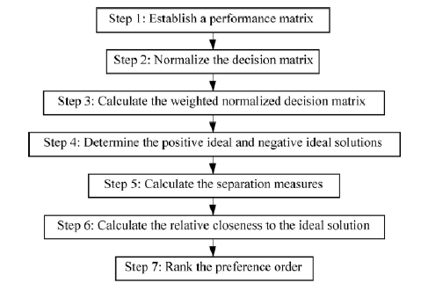
Steps of TOPSIS

Slide 25
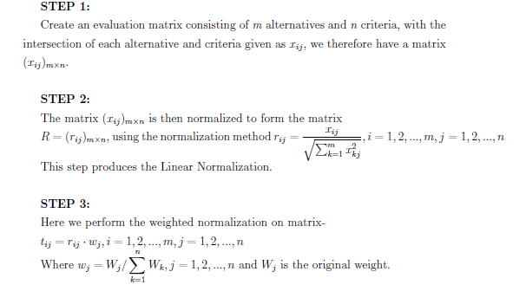
TOPSIS Steps:

Slide 26
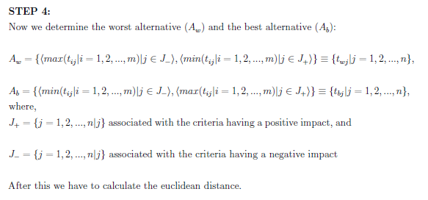
TOPSIS Steps:

Slide 27
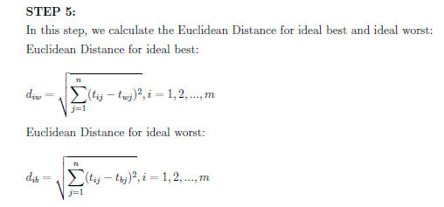
TOPSIS Steps:

Slide 28
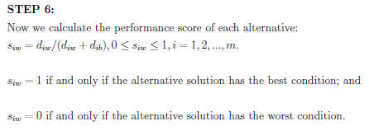

TOPSIS Steps:

Slide 29
Auto-elasticity
The variations in the resources that can be used by a client changes and it is done in an automatic or manual manner.
In manual policy, the user is responsible for monitoring his virtual environment and perform all elastic actions.
In automatic policy, there is no requirement of any user for this purpose instead the control is done by the cloud system according to the user’s requirement.
There are many methods that have been proposed to obtain auto-elasticity on a cloud computing environment like PRESS, Haven, HPA, PID Controller, etc.

Slide 30
Auto-elasticity
PRESS algorithm (PRedictive Elastic ReSource Scaling) was proposed to obtain auto-elasticity in which CPU loads have been predicted by extracting consumption patterns and then adjust resource allocation.
It can predict the resources demands for both repeating and non-repeating patterns of workload.
It is proactive in nature since it predicts the CPU loads and then perform vertical scaling.

Slide 31
Auto-elasticity
Haven is based on a software based approach which provides a system for multi-tenant cloud for load balancing and auto-scaling.
It is based on the monitoring of CPU and memory loads for each virtual machine in a load balancing pool.
Haven loads new virtual machines and loads them in the load balancing pool when CPU and memory threshold values are crossed .

Slide 32
Auto-elasticity
HPA (Horizontal Pod Autoscaler) scales the number of containers that serve a given application when the average CPU consumption by containers is greater than CPU average threshold value.
This autoscaler is implemented as a control loop where it periodically queries the CPU utilization in order to create sufficient number of containers (pods).

Slide 33
Auto-elasticity
PID controllers (Proportional- Integral- Derivative) are control algorithms that are widely used in the industry.
A PID controller has three coefficients- proportional (Kp), integral (Ki) and derivative (Kd).
It basically works in a closed loop system where initially it reads the current value of a particular variable that is being controlled and converged to the desired level.

Slide 34
Auto-elasticity
In PID algorithm, an error is calculated which is the difference between the desired value (setpoint) and the current value of the variable.
This algorithm has three components proportional, integral and derivative and all these components depend upon the error term.
This algorithm is based on a reactive approach because this algorithm converges to the desired response time (setpoint) based on the average response time that is given as input to the algorithm.

Slide 35
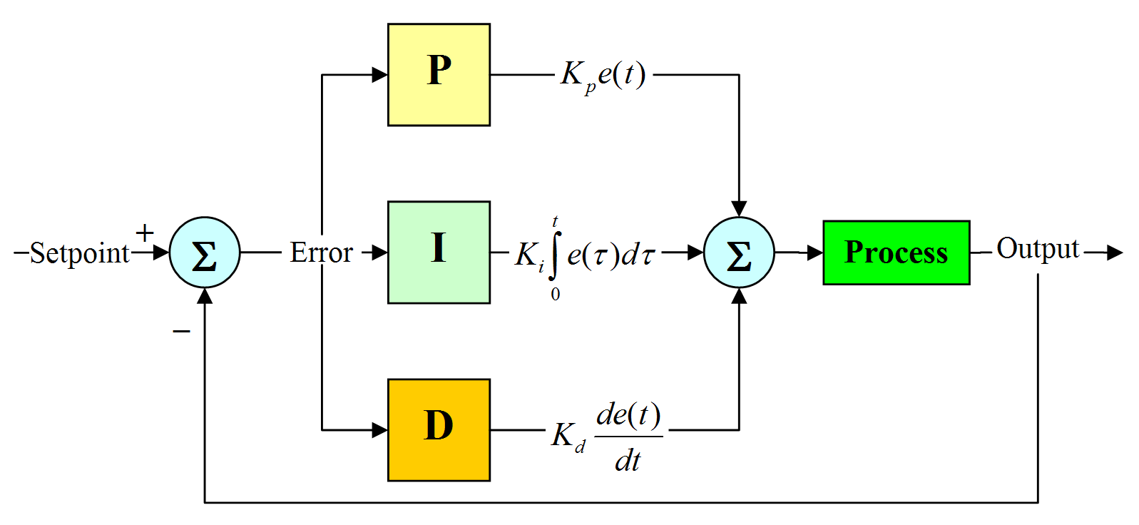
Auto-elasticity
Fig.- PID Controller

Slide 36
Containers in Cloud Computing
Container in cloud computing is basically an approach to operating system virtualization.
The code of the application can be bundled with configurations and dependencies in a systematic manner.
Container in cloud computing help in producing operational efficiency, version control, developer productivity and environmental consistency.
By this, the user is assured of reliability, consistency, and quickness regardless of the distributed platform.

Slide 37
Docker Container
Docker wraps software components into a complete standardized unit which contains everything required to run i.e. runtime environment, tools or libraries.
It provides the facility to run an application in an isolated environment which is called container. It guarantees that the software will always run as expected.
Docker is secure by default because each container is isolated from one another.
Docker has a client-server architecture. Docker client and server can be present on the same host machine or different hosts.

Slide 38
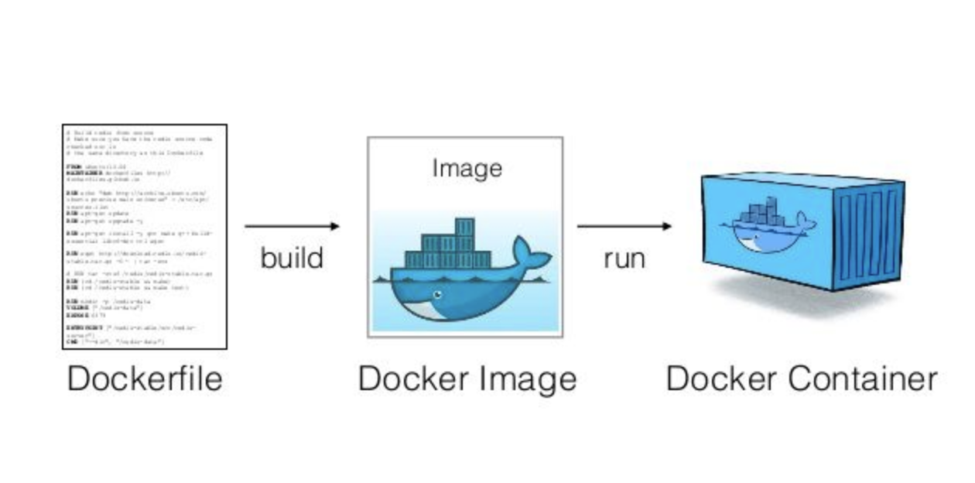
Steps to create a Docker Container
At first, a Dockerfile is created which is a text document that contains all the instructions in order to assemble a Docker image.
After this, the Dockerfile is build to create a Docker image which is the template used to create a Docker container.
Finally, the Docker image is run to create the Docker container. Basically, a container is a running instance of a Docker image.

Slide 39
Docker Compose:
Docker compose is a tool which is used to define and run multi-container docker applications.
The docker-compose.yml file is used to define the services of applications and includes various configuration options.
It also sets resources constraints like milli cores of CPU used (%CPU) and memory limits (%RAM).
The docker-compose CLI utility allows users to run commands on multiple containers at once.

Slide 40
Container Orchestration
Orchestration means managing and controlling multiple docker containers as a single service.
A Container Orchestration System is used to manage running instances of containers by providing features like health checks, scaling number of containers, rolling update of s/w across containers.
Docker Swarm, Kubernetes and Apache Mesos are the tools available for orchestration.

Slide 41
Docker Swarm:
A Docker swarm is a group of machines that are running docker and joined into a cluster as a single virtual system.
A Docker Swarm cluster also provides the ability to easily scale up and down the number of containers and the number of resources needed by each container.
Containers in a swarm are called nodes. Some nodes are made manager and some are made workers.
Clustering enables Docker Swarm failover if one or more nodes stop working.

Slide 42
Thank You!

